Slide 1
Deserts and Desertification lecture 1 collected by : Maher M Mahdi

Slide 2
Definitions: Desert: A region which has an arid climate or where evaporation exceeds precipitation, Concentrated in sub-tropics, mid-latitudes, and polar regions Steppe: region often adjacent to a desert, steppe (semi-arid, surrounds deserts) Semiarid climate: irregular precipitation, enough to generate minimal plant growth

Slide 3
A common definition distinguishes between true deserts, which receive less than 250 millimetres (10 in) of average annual precipitation, and semideserts or steppes, which receive between 250 millimetres (10 in) and 400 to 500 millimetres (16 to 20 in).

Slide 4
Budyko-Lettau dryness ratio
D = R / (L x P)
where D = dryness ratio; R = mean ann. net radiation; P = mean ann. precipitation; L = latent heat of vaporization of water
Original definition:
D > 2.3 = semi-desert; D ≥ 3.4 = desert.
UNESCO: D ≥ 10 = “extreme desert”

Slide 5
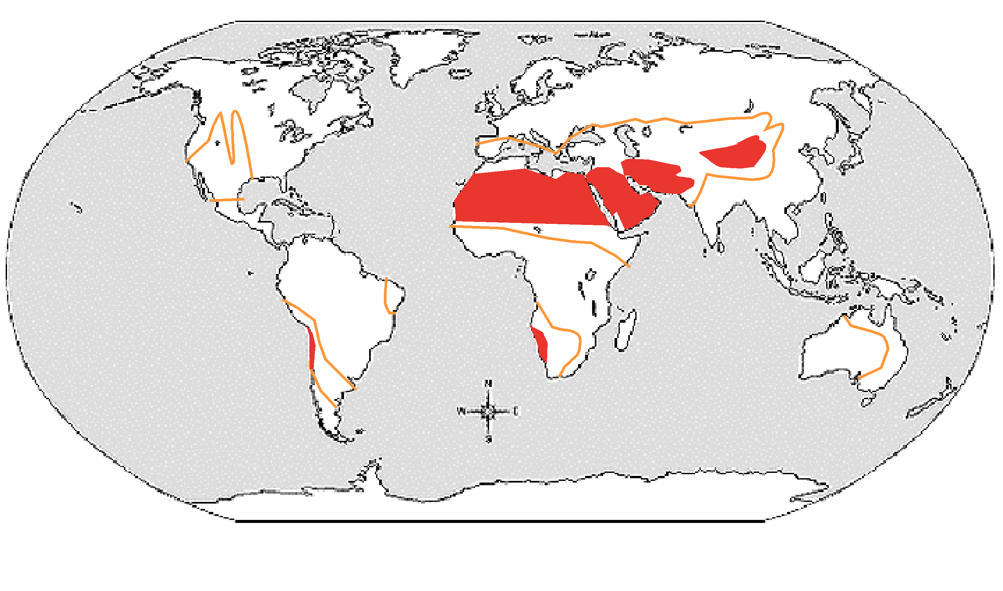
Dryness ratio
8
7
semiarid desert
(D≥2.3) (D≥10)

Slide 7
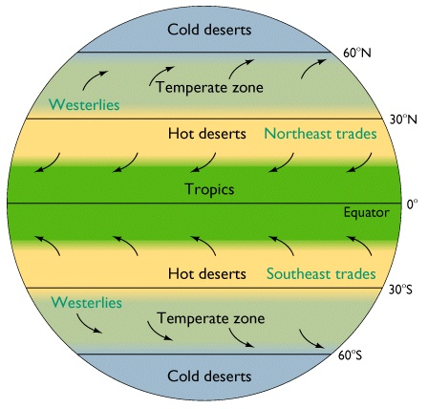

Slide 8
Depending on temperture 1-Cold deserts: can be covered in snow or ice; frozen water unavailable to plant life. These are more commonly referred to as tundra - average precipitation is 10 inch -Cold Deserts temperature in winter ranges from -2 to 4° C and in the summer 21 to 26° C a year -Lies within 70 deg. S-N latitude

Slide 9
2- Hot and Dry Deserts: temperature ranges from 20 to 25° C. The extreme maximum temperature for Hot Desert ranges from 43.5 to 49° C
Lies within 18 -30 deg. S-N Latitude
Humidity decreasing
average precipitation is 10 inch with hard storms
Like Australian desert
high pressure zone (few to rare rain)

Slide 10
3 -Temperate Deserts and Semi-Deserts
It appear in the internal part of continents, in middle latitudes
-Lies within 40 -60 N-S latitude circles
- It not reach to Africa and Australia
- Average temp. is 18 C

Slide 11
Another classification depending on topography :
1. Subtropical: Those associated with the circum-global belts of dry, subtropical air (Sahara, Kalahari, Great Australian)
2. Rain shadow: Lee side of mountain ranges in the rain shadow (Sonoran).
3. Continental interiors: with low rainfall (Gobi, Takla Makan in Asia)
4. Coastal deserts, near the coast (Peru, Chile, SW Africa)
5. Polar deserts (N. Greenland, ice-free areas in Antarctica)

Slide 12
Subtropical –
Centered around 30º N and S latitude
Controlled by air circulation
Geographically extensive

Slide 13
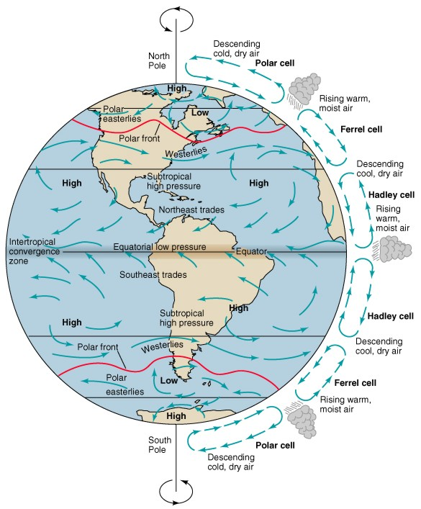
Global
Atmospheric
Circulation

Slide 14
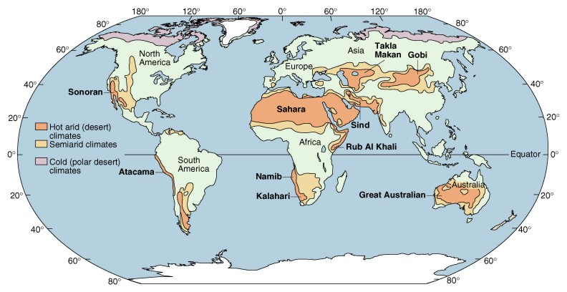
Subtropical Desert
Examples: Sahara and Great Australian

Slide 15
Continental Interior-
Far from sources of moisture (ocean)

Slide 16
Continental Interior Desert
Example: Gobi in Mongolia

Slide 17
Types of Deserts
Rainshadow-
Rain shadow deserts are formed because tall mountain ranges prevent moisture-rich clouds from reaching areas on the lee, or protected side, of the range.

Slide 18
Rainshadow Desert
Examples: Cascades and Sierra Nevada

Slide 19
Coastal Desert -
Cool dry air blows in from the ocean and evaporates occurs as it warms.

Slide 20
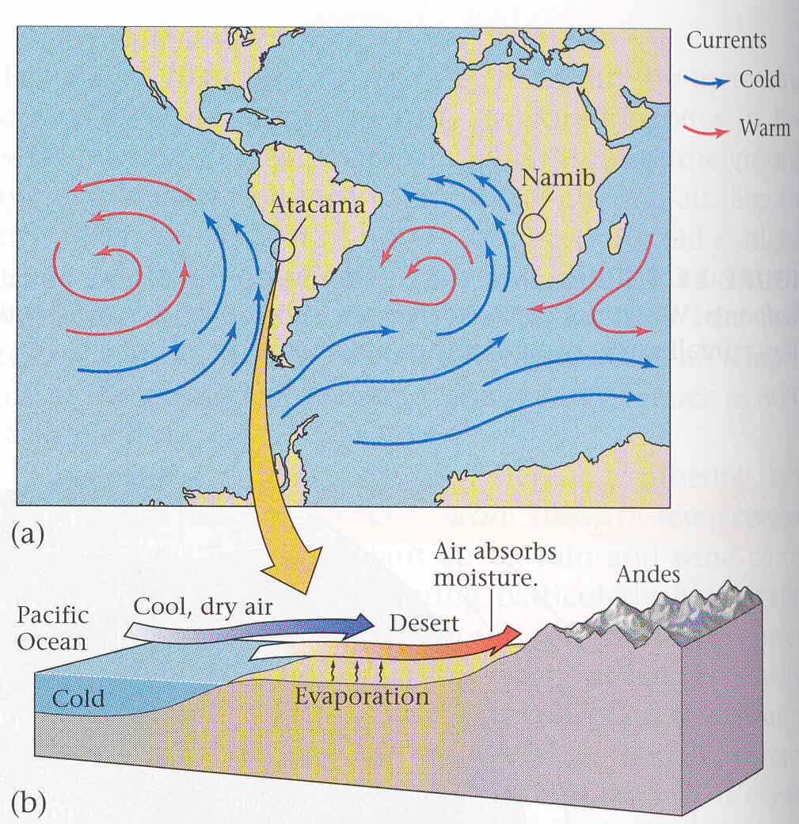

Slide 21
Coastal Desert
Example: Coast of Chile and Peru

Slide 22
Polar –
Cold air holds very little moisture.
What little precipitation falls remains as ice for 1000's of years.
Examples: Greenland and Antarctica

